Slide 1


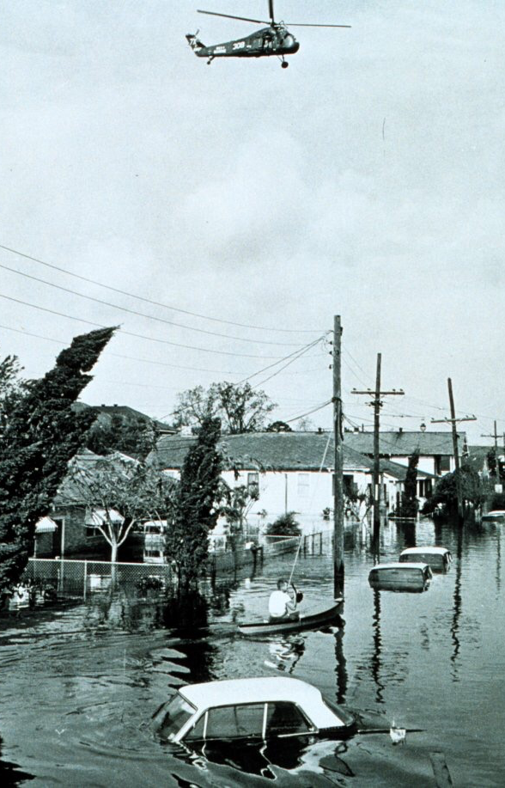
The National Flood Insurance Act of 1968
Will Mohr

Slide 2
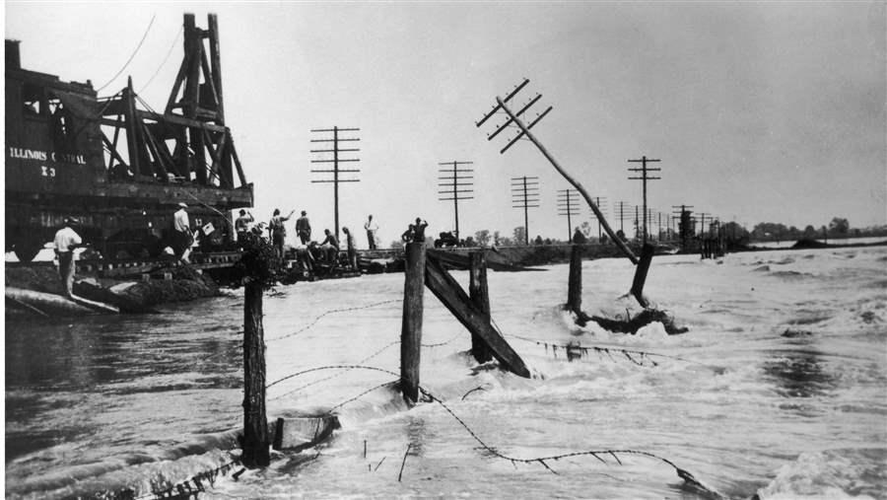
The Great Mississippi River Flood
$4.2B to $17.3B in damage, up to 1/3 of the federal budget at the time
27,000 square miles were flooded, 700,000 people rendered temporarily homeless
Denuding riverbanks upstream of wetlands and forest reduced capacity to absorb excess water
Consequent mitigation attempts through heightening, strengthening of levees possibly exacerbated later floods by increasing speeds

Slide 3
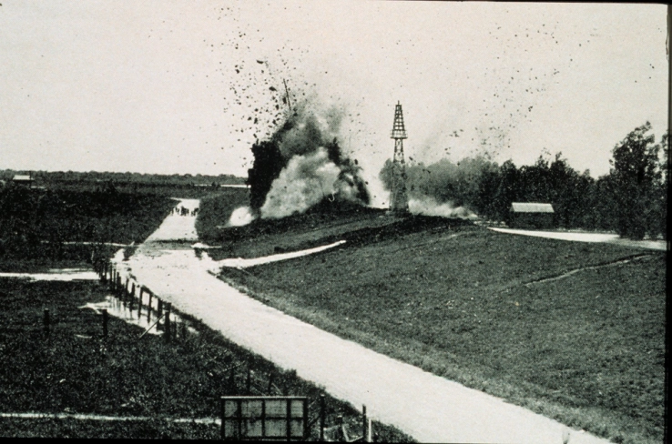
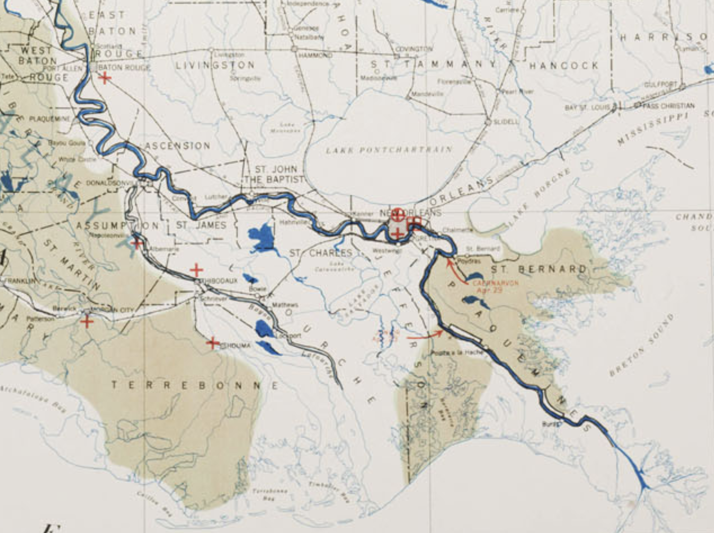
St. Bernard Parish vs. New Orleans, Bankers vs Trappers
“a break is anticipated somewhere in Louisiana between Vicksburg and Natchez… [Missisippi] would send part of the water down the Atchafalaya Outlet and thereby relieve the situation at New Orleans.”
Governor Simpson was eventually convinced by a committee of New Orleans bankers to dynamite the levee at Caernarvon
Bankers sought to reassure investors of property safety
April 29th detonation. Day after, upstream break in levee, Atchafalaya Outlet relieves pressure.

Slide 4
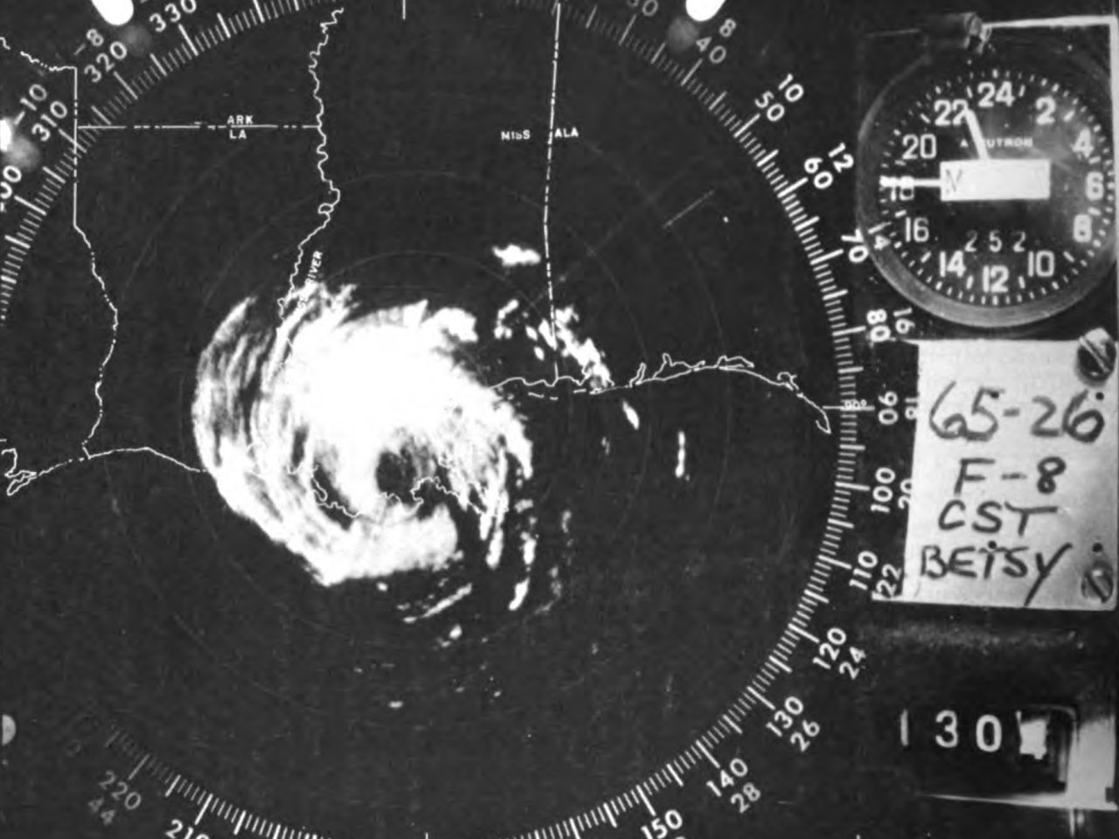
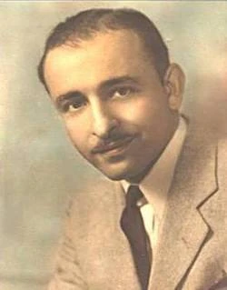
Hurricane Betsy
August 27th - Sep. 13th 1965
$1.42B in damage nationwide
Extensive crop damage
167,000 homes in Louisiana flooded, most in Lower 9th ward
Industrial Canal levee fails, floods the Upper/Lower 9th Ward, resulting in conspiracy theory of detonation
L. B. J. Promises Mayor Vic Schiro relief for New Orleans

Slide 5
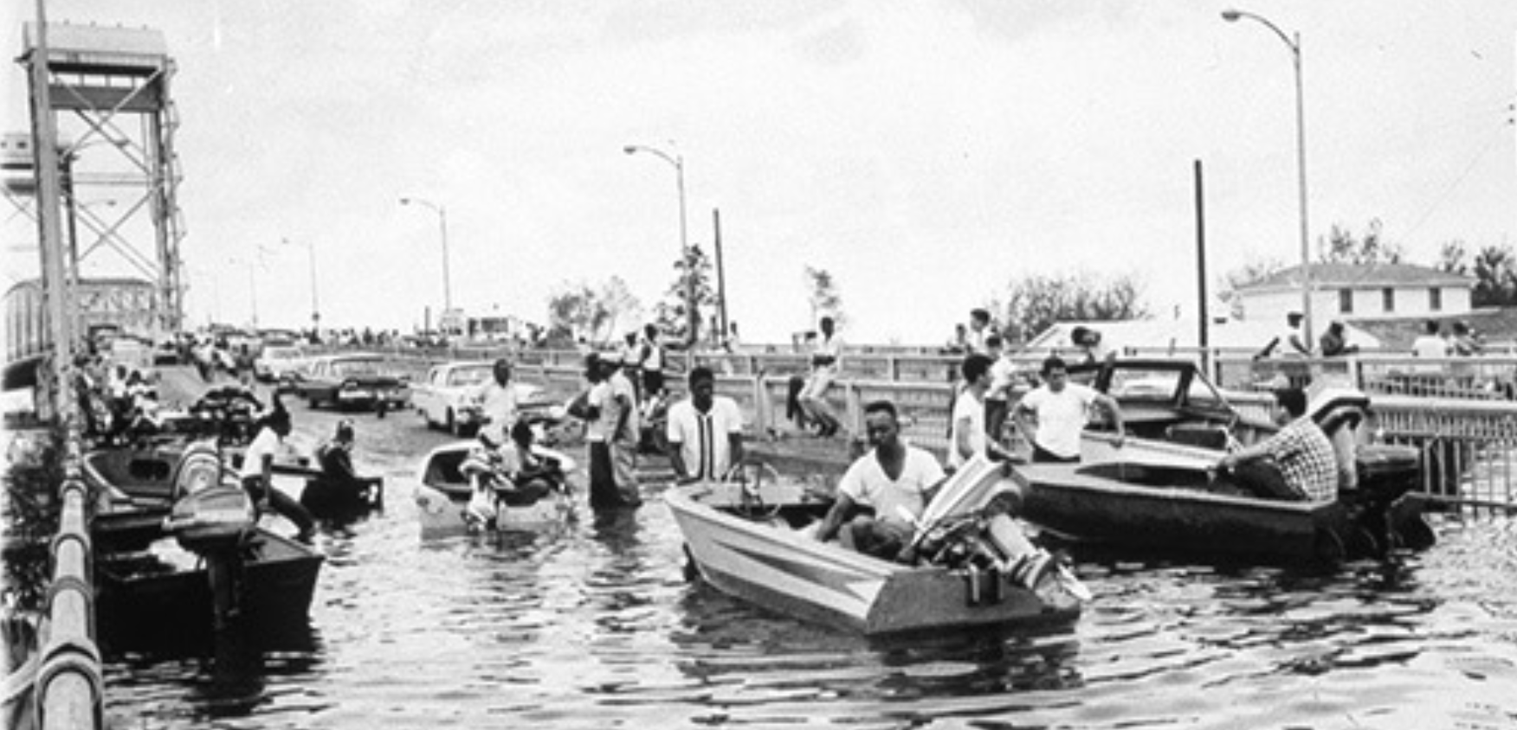
Flooding of the 9th Ward
Residents hear a “boom”, followed by intense flooding on the night of September 9th
Radio reporting attributes the levee breach to the mayor. Racist implementation of relief efforts
Senator Allen Ellender had vowed to filibuster
the Voting Rights Act, Schiro opposed desegregation
Quietly, engineers close a siphon connecting the Lower 9th to Gentilly
Rest of city celebrates a quick recovery while 9th Ward is still under water

Slide 6
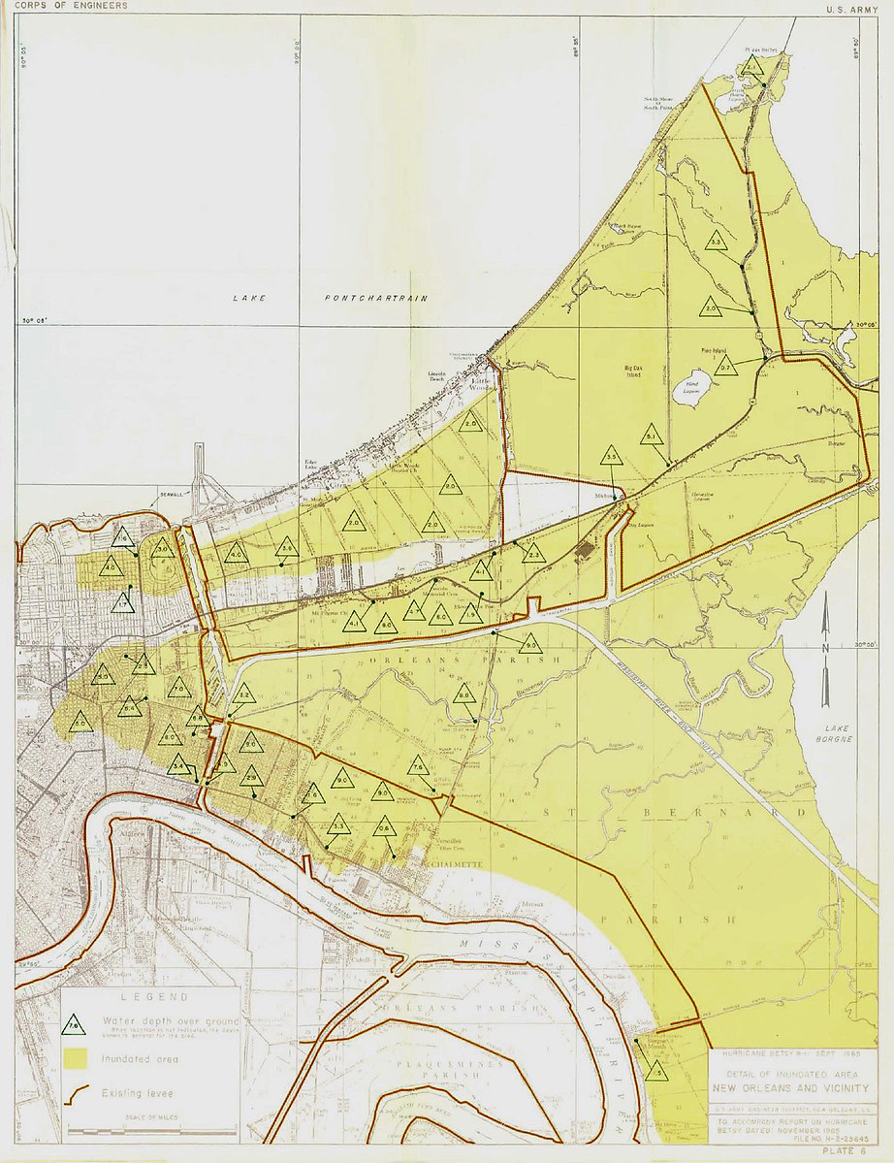
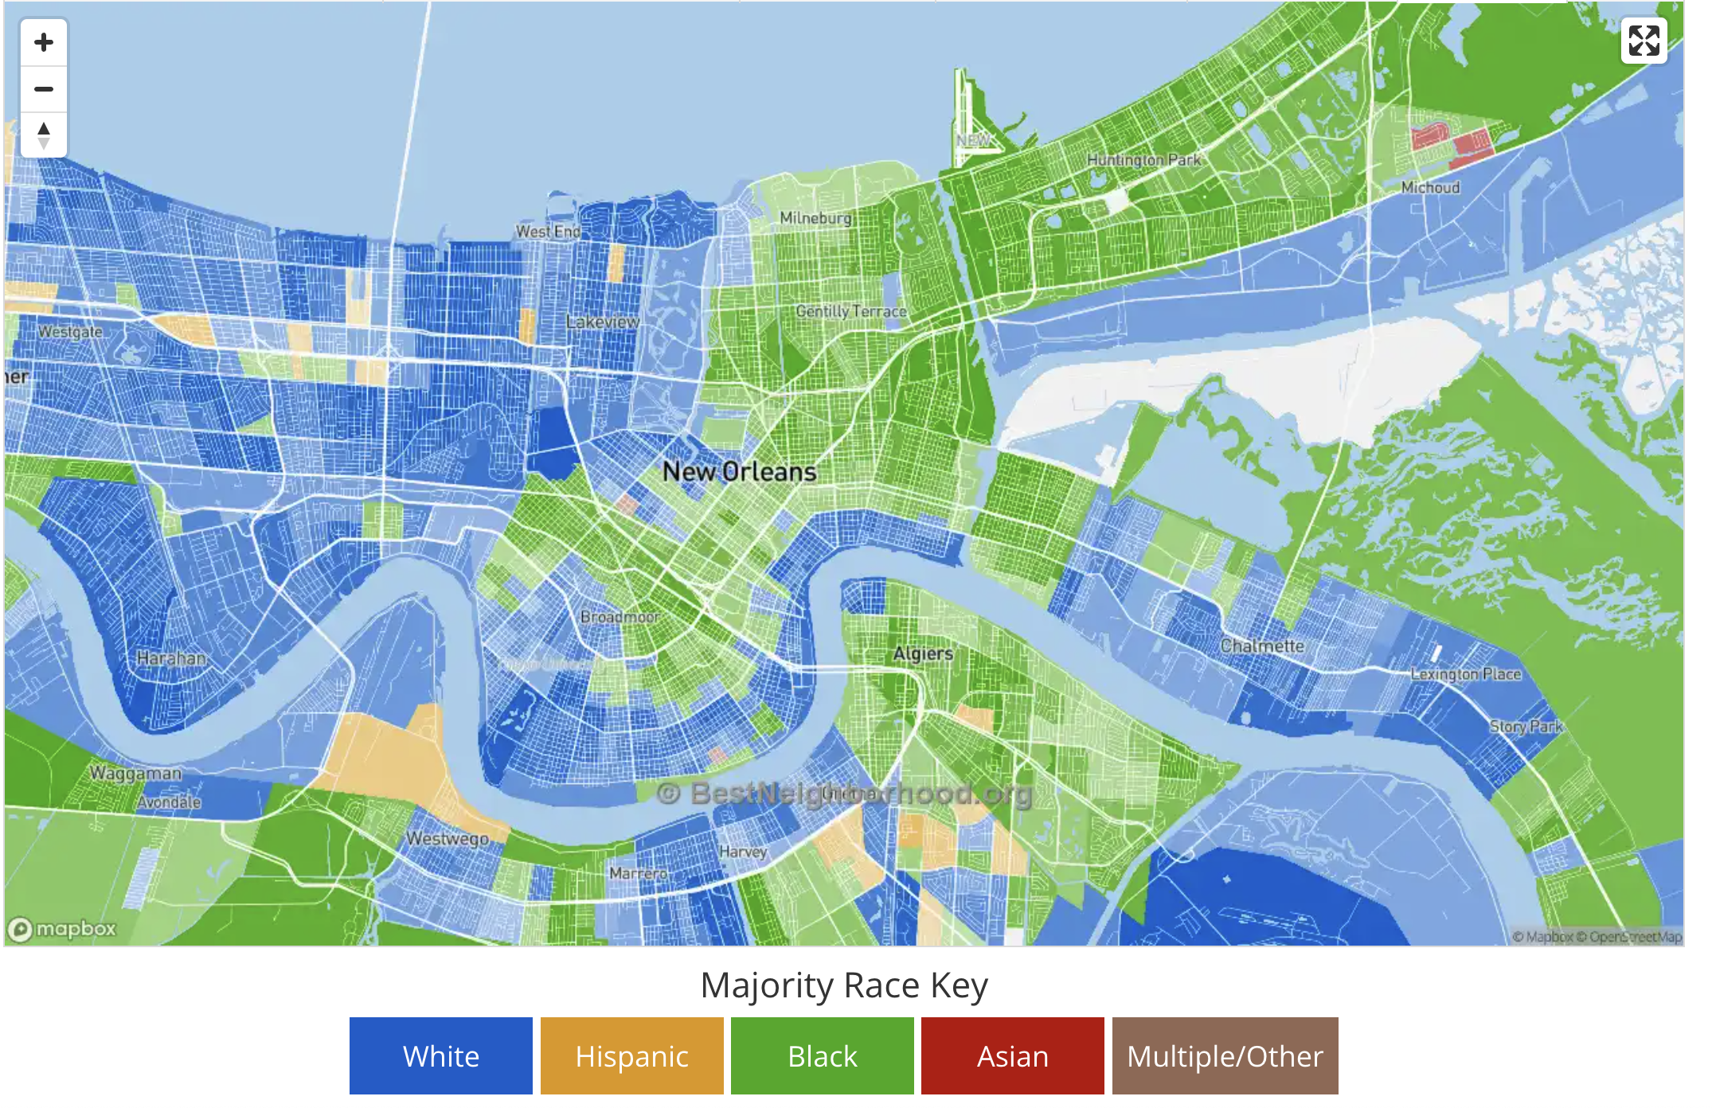
Framing the Cause and Due Response
Congressman F. Edward Hebert deflects charges of neglect on to natural unpredictability
Urges “individual” resilience from a neighborhood that was 90% black, historically marshland, and offered one of the few opportunities for home ownership in a time of segregationist zoning
Edward Teller , nuclear scientist contradicts politicians (Mayor Schiro, Gov. McKeithen): “…tidal wave action can be anticipated”
Does fault lie with nature, or are governmental bodies responsible?
L. B. Johnson: Betsy was “… an injury … done by nature”

Slide 7
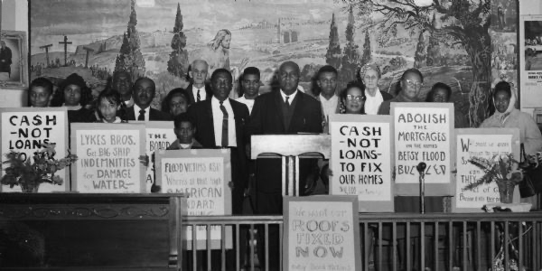
Betsy Flood Victims
Demands:
$10,000, ($99K 2024)
Mortgage and debt freezes
Food stamps, safe levees, and the end of the Vietnam War
Sen. Long and Rep. Boggs respond, requesting unprecedented legislation for $5K grants to the uninsured. Rep. Hebert blocks the $24M aid package
An October “Betsy Forgiveness Bill” forgives up to $1800 XS of $500 of SBA loans made to victims
Elizabeth Rogers of the BFV sends petition to Long supported by 3000 signatures with the plea that the 9th Ward homeowners would largely not benefit, because any loan was would be unaffordable
8,000 out of 33,000 loan requests were denied.

Slide 8
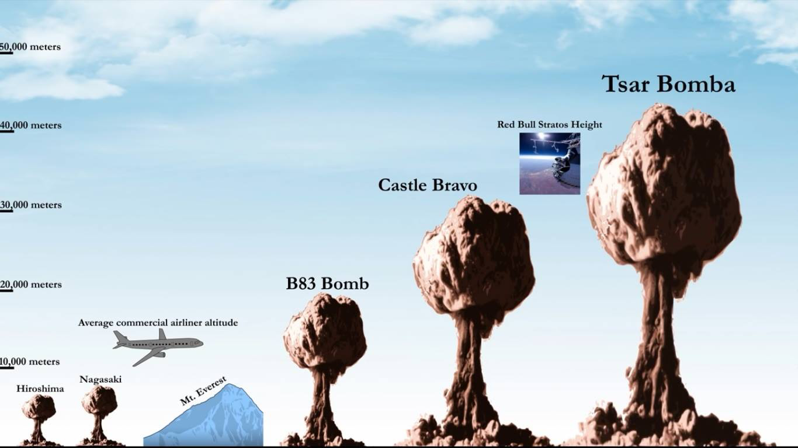
Evolutions in Civil Defense From the Bomb to Betsy
In 1951 Truman signed the Federal Civil Defense Act - later repurposed under a broader mandate
Truman requests a flood insurance program repeatedly from ‘51 to ‘53
Eisenhower achieves legislation with the Federal Flood
Insurance Act (1957), but a lack in technical studies
leads Congress to deny funding
The Southeast Hurricane Disaster Relief Act in response to Betsy brings some relief but calls for a study on disaster relief that includes insurance and reinsurance

Slide 9
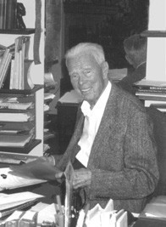
Hazard Research
The Gilbert F. White chaired Bureau of Budget Task Force on Federal Flood Policy delivers a 1966 report
Conducted studies on flood plains and their management, as well as potential insurance programs
”Expert” implementation, or no implementation.
Premiums need to reflect risk or they will incentivize risky development
Insurance can’t ensure survival or indemnify against intangible tragedies
The end goal is rational floodplain management as ecosystems
A 1966 Housing and Urban Development report echoed support for subsidized insurance and a gradual rollout, though offered less cautious conclusions

Slide 10
Inter-Agency Collaboration
The Task Force on Federal Flood Policy finds roles for several agencies
USGS: Releases in 1967 a 19-volume detail on flood magnitude and frequency
U.S. Army Corps of Engineers: compiles list of at-risk streams and municipalities. Releases Guidelines for Reducing Flood Damages and determines 5,000 communities to be at risk
Water Resource Council: recommends “methodologies and standards to be used in developing information about flood hazards, including delineation of the floodplain, elevations that floods of various magnitudes would reach, flood velocities, and the probability of floods of various magnitudes.”
WRC’s recommendations is adopted by 26 agencies and originates the 100-year flood concept, which now factors into flood insurance rates

Slide 11
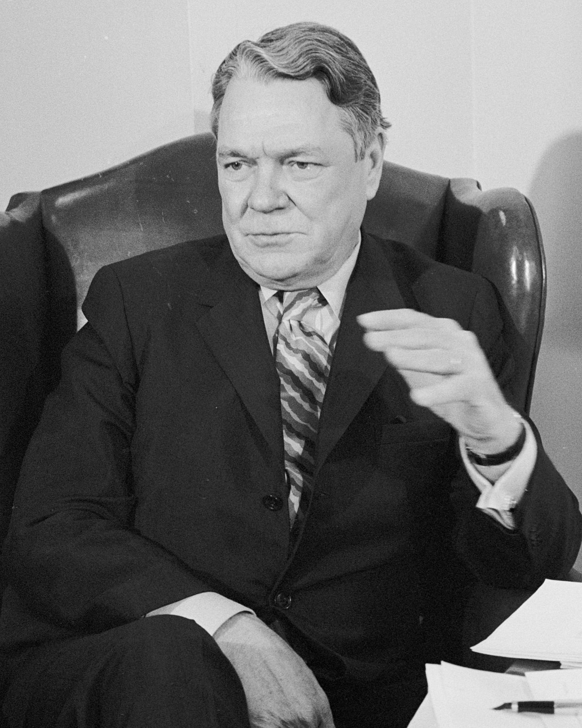
Success… nominally
Rep. Hale Boggs, Democratic majority whip, supported by industry interest, successfully steers the NFIA through Congress
89 companies form The National Flood Insurers Association and promise $42 million
Special Flood Hazard Areas required to zone appropriately
1969 Hurricane Camille (cat 5) causes $1.4 B in losses, with only two communities insured
Emergency measures, ahead of actuarial rate analysis and flood mapping, still leave 99% of losses uninsured for 1972 Hurricane Agnes
Later acts institute insurance requirements, allow insurance companies to write and market policies

